Slide 1
11/26/18 Bell Work
Write and answer the following questions.
Simplify the following expressions. No Decimals.
4. $3\sqrt{400b^{4}}$ 5. $\sqrt{60r^{3}n^{3}}$

Slide 2
11/27/18 Bell Work
Write and answer the following questions.
Simplify the following expressions. No Decimals.
1. $\sqrt{252{pq}^{2}r}$ 2. $\sqrt{18x^{2}y^{3}z^{4}}$

Slide 3
11/28/18 Bell Work
Write and answer the following questions.
Consider $f\left(x\right)=x^{2}+3x+4$. Evaluate the function for each given value.
$f\left(1\right)=$
2. $f\left(−1\right)=$
3. $f\left(2\right)=$
4. $f\left(−2\right)=$

Slide 4
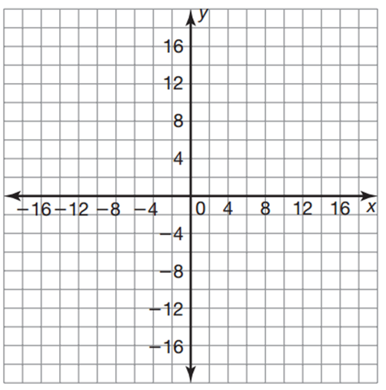
11/29/18 Bell Work
Write and answer the following questions.
Graph the function $f\left(x\right)=x^{2}+3x+4$ on the provided graph.
x | f(x)
-3
-2
-1
0
1
2
3

Slide 5
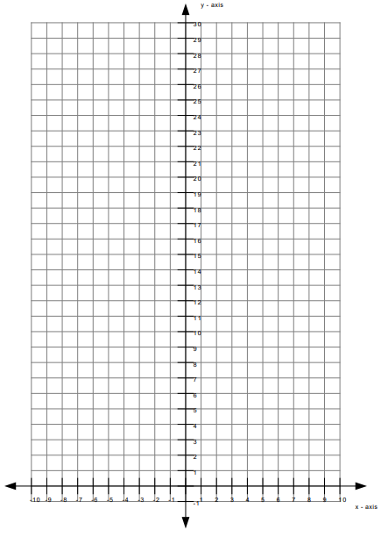
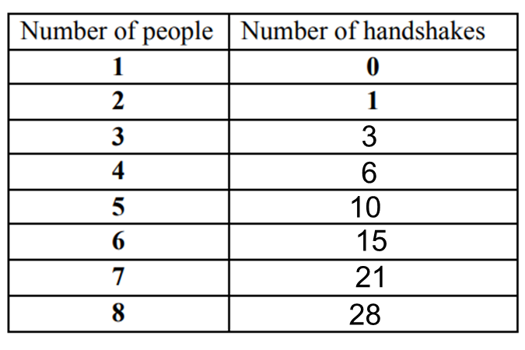
11/30/18 Bell Work
Write and answer the following questions.
Graph our function from yesterday $f\left(x\right)=\frac{x(x−1)}{2}$ on the provided graph.

