Slide 1
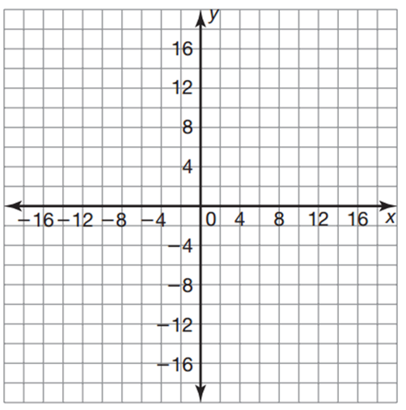
11/12/18 Bell Work
Write and answer the following questions.
Graph the function $f\left(x\right)=2{(4)}^{x}$ on the provided graph.
x | f(x)

Slide 2
11/13/18 Bell Work
Write and answer the following questions.
Graph the function $f\left(x\right)=2{(0.5)}^{x}$ on the provided graph.
x | f(x)

Slide 3
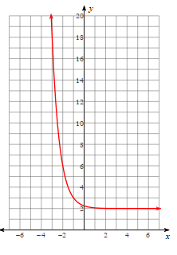
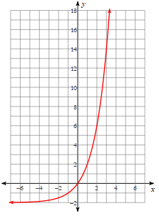
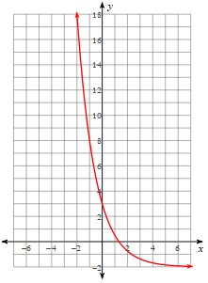
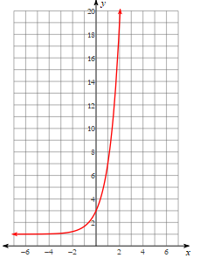
11/14/18 Bell Work
Write and answer the following questions.
Label each graph as growth or decay.
1. 2.
3. 4.

Slide 4
11/14/18 Bell Work
Write and answer the following questions.
Solve for the variable x.
1. $2^{2x}=2^{2}$ 2. $2^{4x}=2^{20}$
3. $2^{x}=8$ 4. $2^{2x−2}=2^{2}$

Slide 5
11/15/18 Bell Work
Write and answer the following questions.
Solve for the variable x.
1. $−x−3=24+3x$ 2. $4−2x=1−3x$
3. $4x+3=−25$ 4. $−28x−14=4∙6x$

