Slide 1
11/5/18 Bell Work
Write and answer the following questions.
Determine each product or quotient. Write each answer with the given base and a single exponent.
$\left(2^{3}\right)\left(2^{5}\right)$
$\frac{2^{4}}{2^{8}}$
$\frac{5^{5}}{5^{4}}$
$4^{0}∙4^{1}$

Slide 2
11/7/18 Bell Work
Write and answer the following questions.
1.
2.

Slide 3
11/8/18 Bell Work
Write and answer the following questions.
Write and simplify the following expressions:
1. 5.
2.
6.
3.
7.
4. 8.

Slide 4
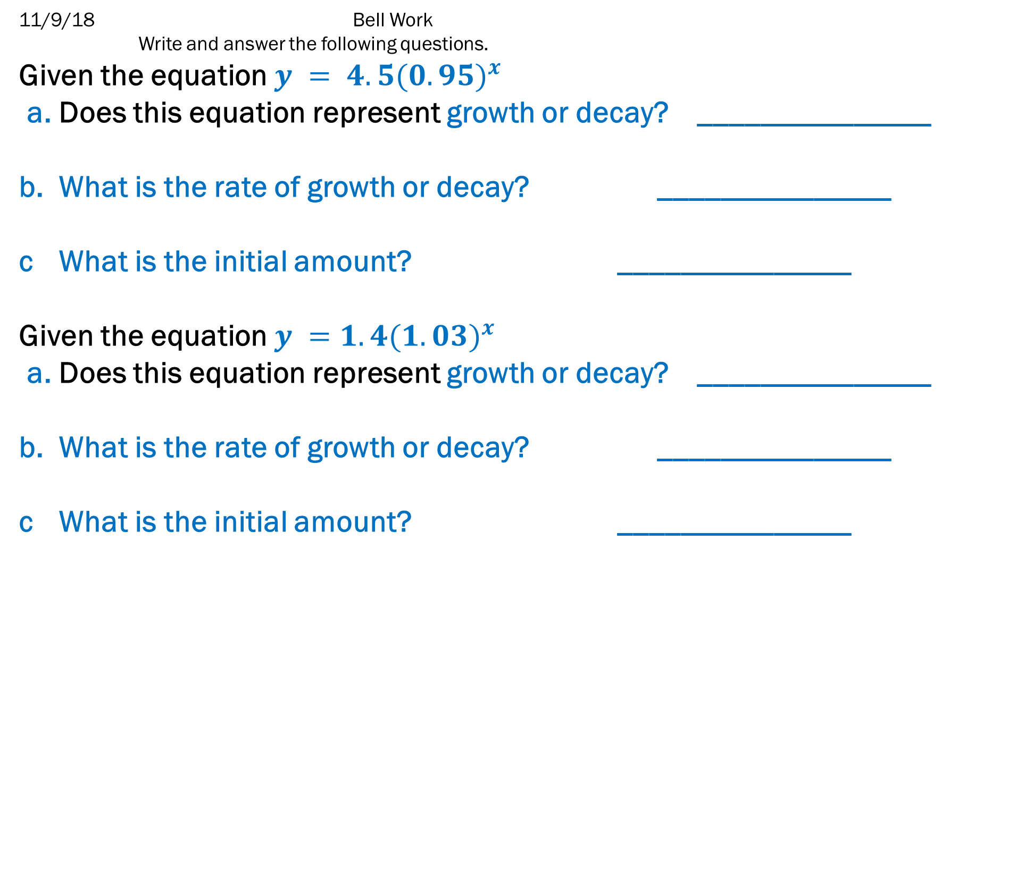
11/9/18 Bell Work
Write and answer the following questions.
Given the equation $y = 4.5{(0.95)}^{x}$
a. Does this equation represent growth or decay? _______________
b. What is the rate of growth or decay? _______________
c What is the initial amount? _______________
Given the equation $y =1.4{(1.03)}^{x}$
a. Does this equation represent growth or decay? _______________
b. What is the rate of growth or decay? _______________
c What is the initial amount? _______________

Slide 5
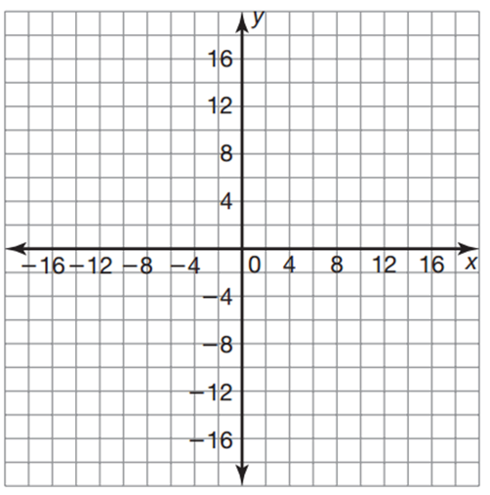
11/9/18 Bell Work
Write and answer the following questions.
Graph the function $f\left(x\right)=2{(4)}^{x}$ on the provided graph.
x | f(x)

