Slide 1
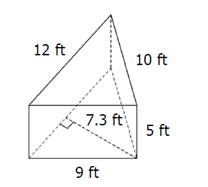
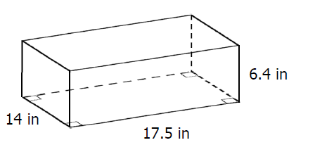
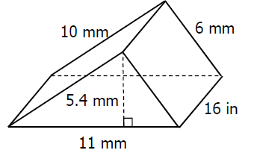
10/29/18 Bell Work
Write and answer the following questions.
Find the surface area of the shapes.
1. 2. 3.

Slide 2
11/2/18 Bell Work
Write and answer the following questions.
Determine each product or quotient. Write each answer with the given base and a single exponent.
$\left(2^{3}\right)\left(2^{5}\right)$
$\frac{2^{4}}{2^{8}}$
$\frac{5^{5}}{5^{4}}$
$4^{0}∙4^{1}$

