Slide 1
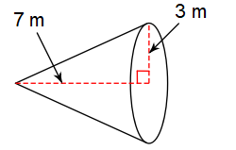
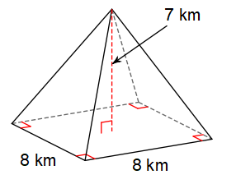
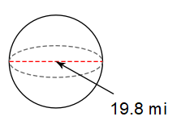
10/24/18 Bell Work
Write and answer the following questions.
Find the volume of the shapes.
1. 2. 3.

Slide 2
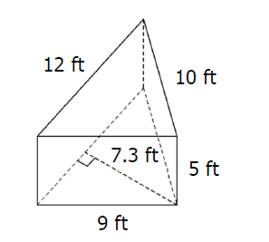
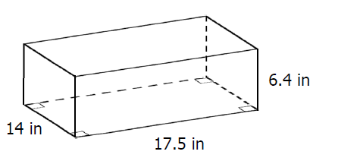
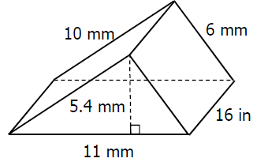
10/25/18 Bell Work
Write and answer the following questions.
Find the volume of the shapes.
1. 2. 3.

