Slide 1
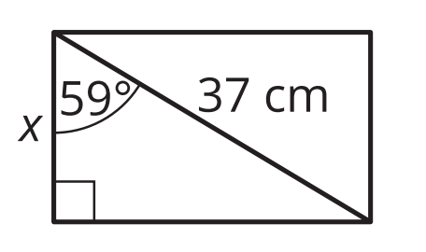
10/15/18 Bell Work
Write and answer the following questions.
Use a trigonometric ratio to determine the width of the rectangle shown. Round your answer to the nearest tenth of a centimeter.

Slide 2
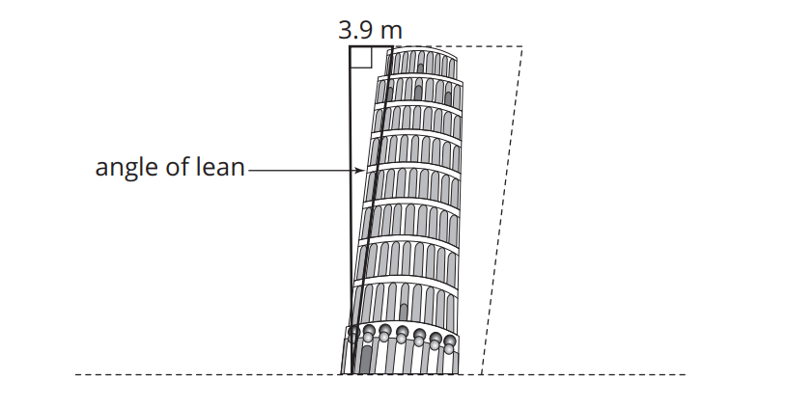
10/16/18 Bell Work
Write and answer the following questions.
The Leaning Tower of Pisa is a tourist attraction in Italy. It was built on unstable land, and as a result, it really does lean!
The height of the tower is approximately 55.86 meters from the ground on the low side and 56.7 meters from the ground on the high side. The top of the tower is displaced horizontally 3.9 meters as shown. Determine the angle at which the tower leans.

Slide 3
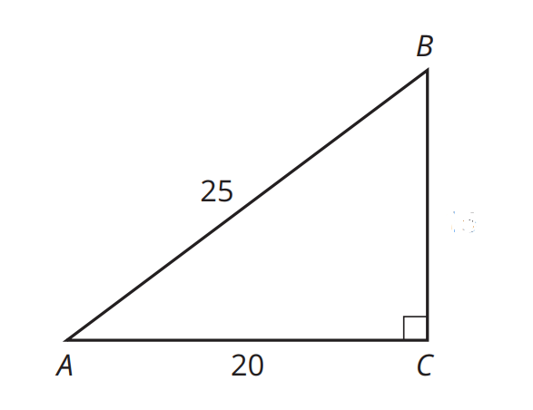
10/18/18 Bell Work
Write and answer the following questions.
In the figure shown, sin(⁡B) = 0.80.What is the length of AB?

