Slide 1
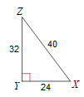
10/8/18 Bell Work
Write and answer the following questions.
1. What is the tangent ratio?
2. $\tan\left(X\right)=$ 3. $\tan\left(Z\right)=$ 4. $\tan\left(21\right)=$

Slide 2
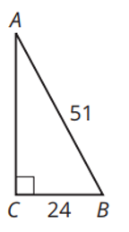
10/9/18 Bell Work
Write and answer the following questions.
1. What is the sine ratio?
2. $\sin\left(X\right)=$ 3. $\sin\left(Z\right)=$ 4. $\sin\left(B\right)=$

Slide 3
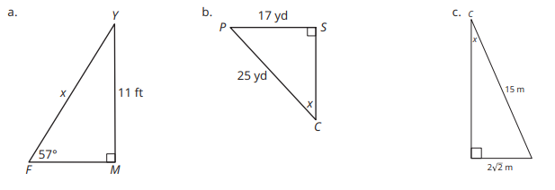
10/11/18 Bell Work
Write and answer the following questions.
Use the sine ratio or the inverse sine to solve for x. Round each answer to the
nearest tenth.

Slide 4
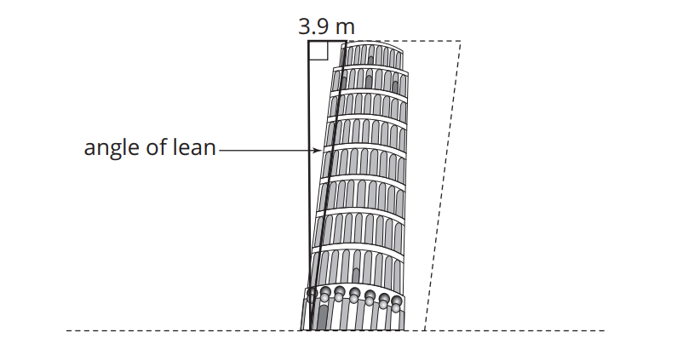
10/11/18 Bell Work
Write and answer the following questions.
The Leaning Tower of Pisa is a tourist attraction in Italy. It was built on unstable land, and as a result, it really does lean!
The height of the tower is approximately 55.86 meters from the ground on the low side and 56.7 meters from the ground on the high side. The top of the tower is displaced horizontally 3.9 meters as shown. Determine the angle at which the tower leans.

Slide 5
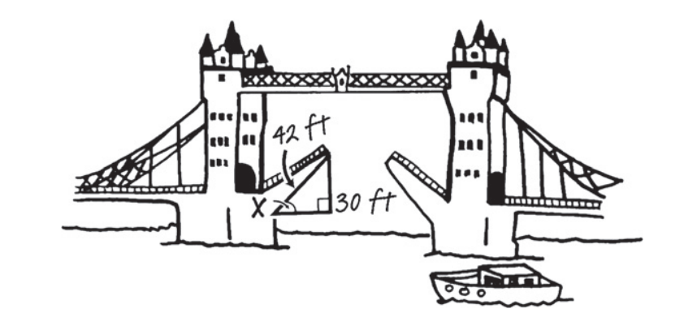
10/12/18 Bell Work
Write and answer the following questions.
The movable bridge shown is called a double-leaf Bascule bridge. It has a counterweight that continuously balances the bridge deck, or “leaf,” throughout the entire upward swing, providing an open waterway for boat traffic. The counterweights on double-leaf bridges are usually located below the bridge decks.
The length of one leaf, or deck, is 42 feet. The maximum height of an open leaf is 30 feet. Calculate the measure of the angle formed by the movement of the bridge.

